Slide 1
INVESTMENT CASE STUDY SUBMISSION
Group Name:
Member name : Sreekanth Settur
Member name : Srivalli Munagapati
Member name : Mathew Kenny Thomas
Member name : Aditya Rajeevan

Slide 2
Key-points
This is performed as a case study to identify better options to invest in various countries along with respective sectors.
This analysis has been done using the past investment data that showcases various countries with their number of investments in major sectors.
During this analysis we have identified and focused on top English speaking countries.

Slide 3

Problem solving methodology
Merged data
Rounds dataset
Companies dataset
mapping dataset
Key = company permalink
Merged data
Top9 Counties
Check for total investment amount
5M to 15M
Top3 Countries
Top3 Sectors
Venture Seed Private_Equity
identifying for best Funding Type (FT)
Best FT

Slide 4
Stages Of Analysis
Investment type analysis:
Considering the investment amount from $5Million to $15Millon, to identify the appropriate funding type.
Country analysis:
Based on sum of investments on chosen funding type, need to identify top9 countries and deriving to top3 English speaking countries with highest sum of investments .
Sector analysis:
Based on the country & investment type analysis, we drilled down the top3 sectors having highest number of investments.

Slide 5
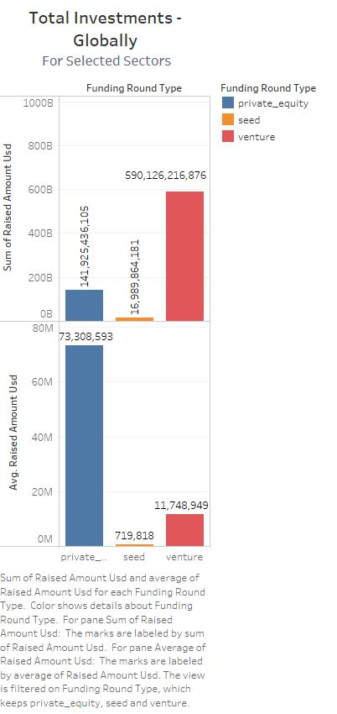

Slide 6
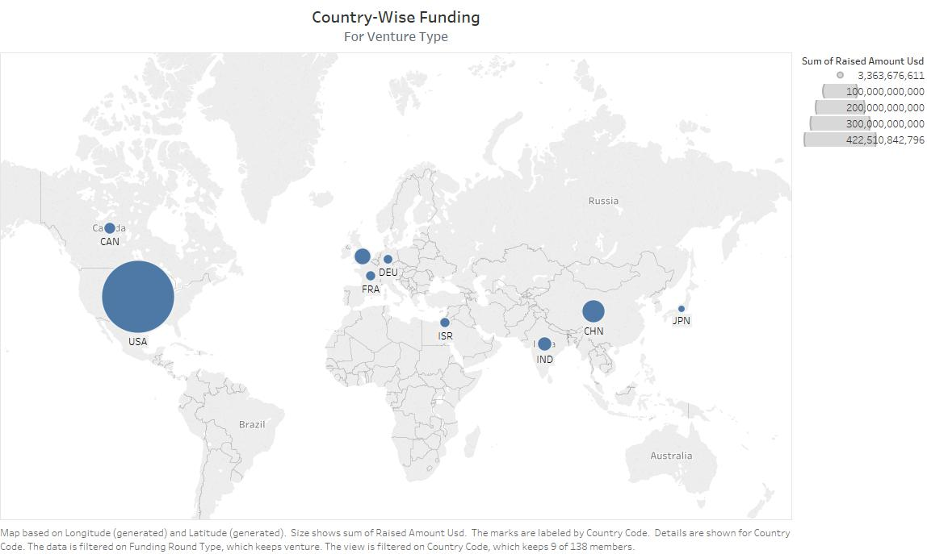

Slide 7
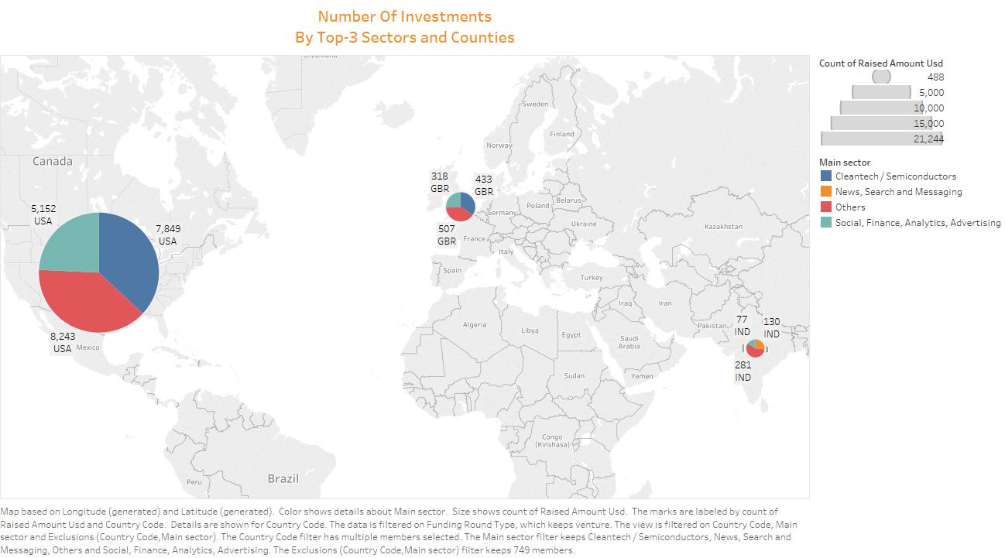

Slide 8
Conclusions
As per the Analysis we draw below conclusions:
Appropriate funding type could be ‘venture’ type
Keeping the companies interest to invest in the English speaking countries, and also the top countries in which investments were made are USA ,UK and India.
The sectors of interests within the above mentioned countries, which captured more number of investments are:
Others in USA, UK, and India.
Cleantech/ Semiconductors in USA and UK and News, Search and Messaging in India.
Social Finance, Analytics & Advertising in all top3 countries.
Companies from Top 3 Countries received highest investments from “Other” Sector:
AirTight Networks – USA
Myntra – India
Electric Cloud – UK

